Slide 1
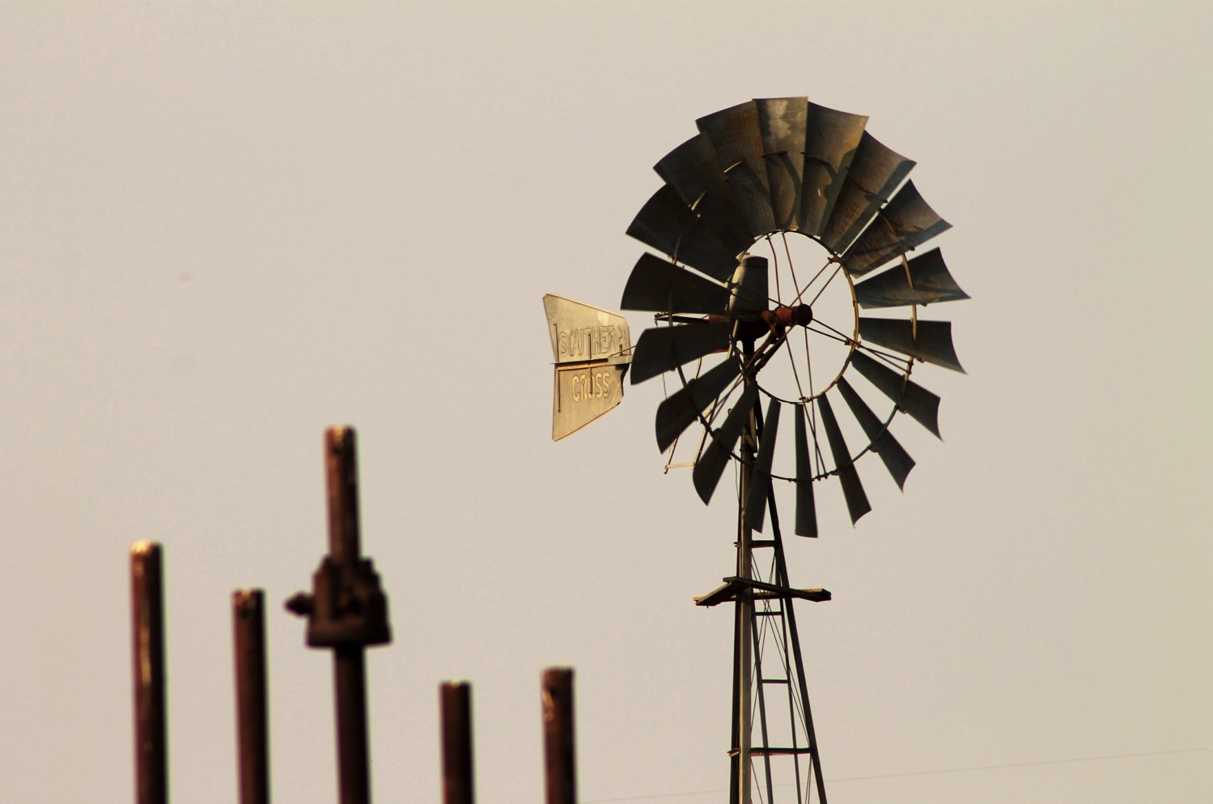
Renewable source of energy: Wind

Slide 2
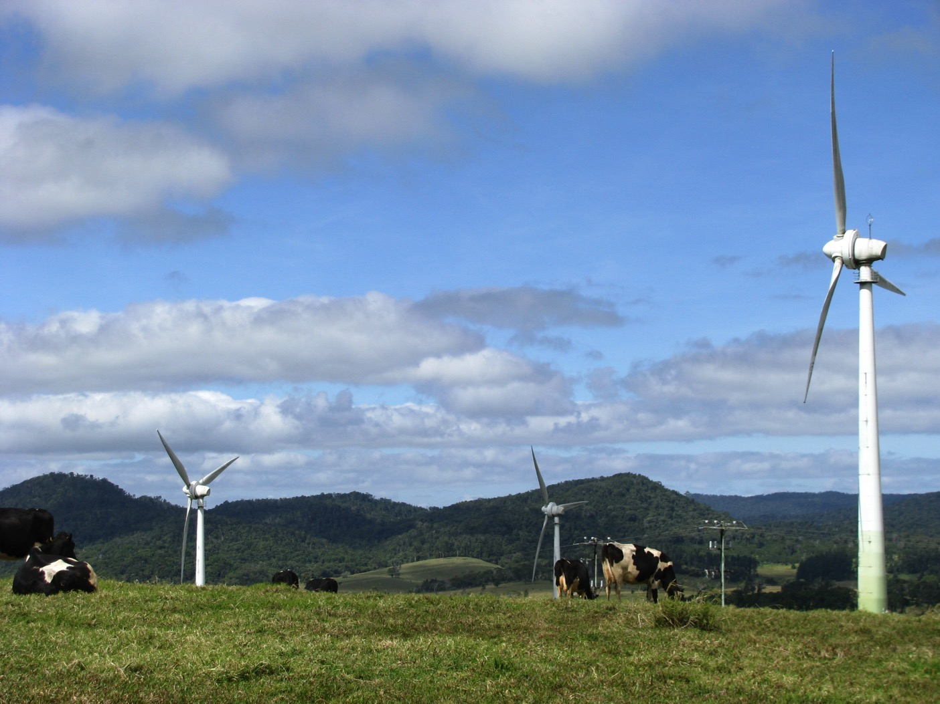
Wind energy
Wind energy is defined as the ‘power generated by harnessing the wind’.
Wind is the ‘force’ of air blowing across Earth’s surface.
Over 4000 years ago wind power was used by the Babylonians and Chinese to pump water for irrigating crops.
In the Middle Ages in Europe windmills were used to grind corn.

Slide 3
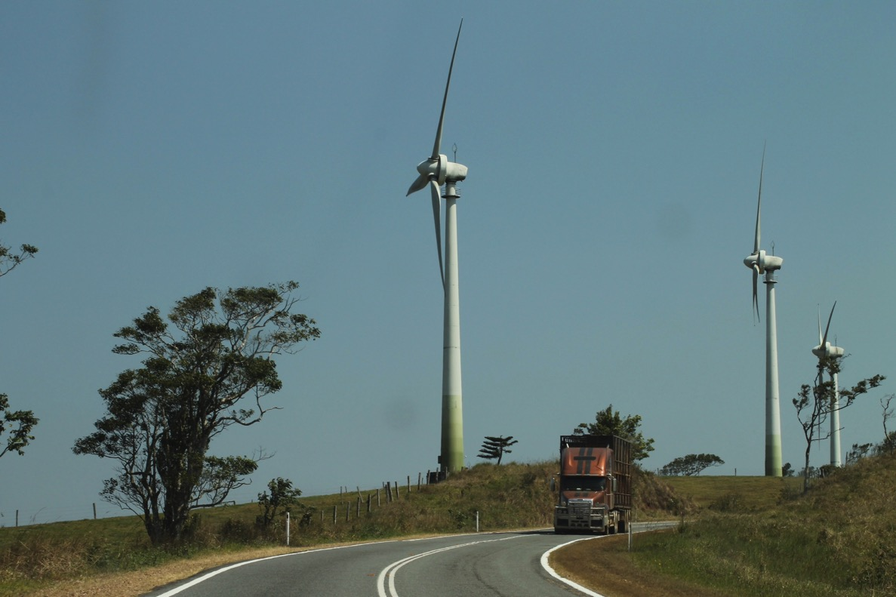
How does it work?
We use the energy in the wind by building a tall tower, with a large propeller / wind turbine on the top.
The wind blows the propeller around, which turns a generator to produce electricity.

Slide 4
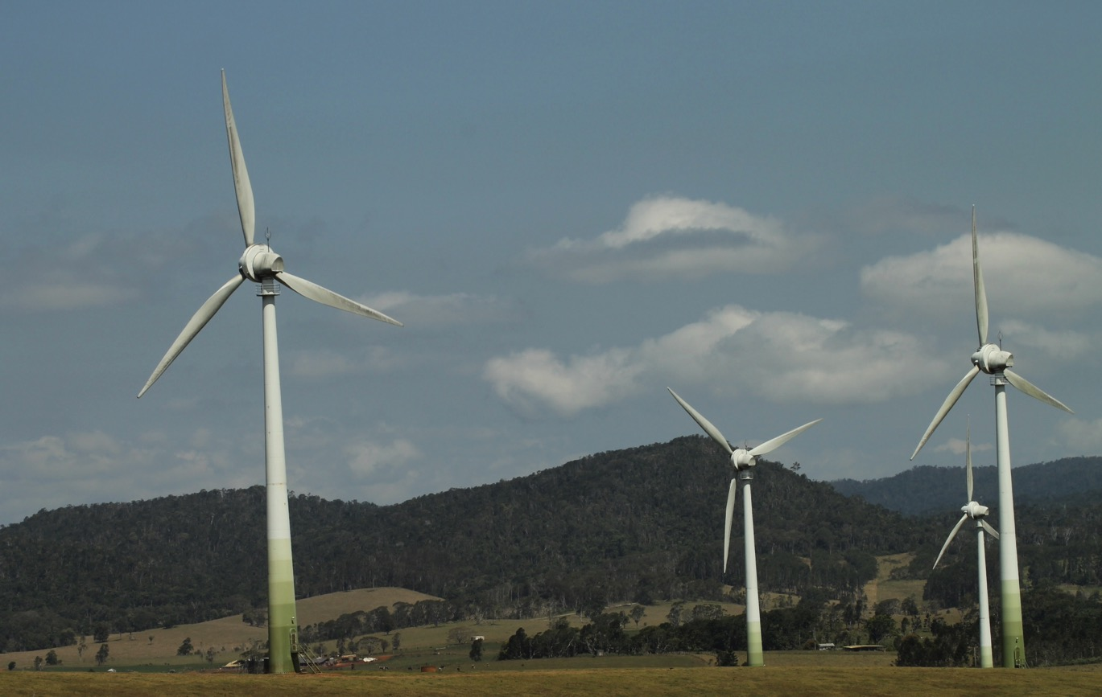
Advantages
Wind is free.
No pollution is produced as no fossil fuels are needed to power machinery.
The land where wind turbines are situated can still be used, e.g. cattle can graze around wind turbines.
Power can be easily supplied to remote areas through local wind farms.
Wind turbines are available in a range of sizes depending on need.

Slide 5
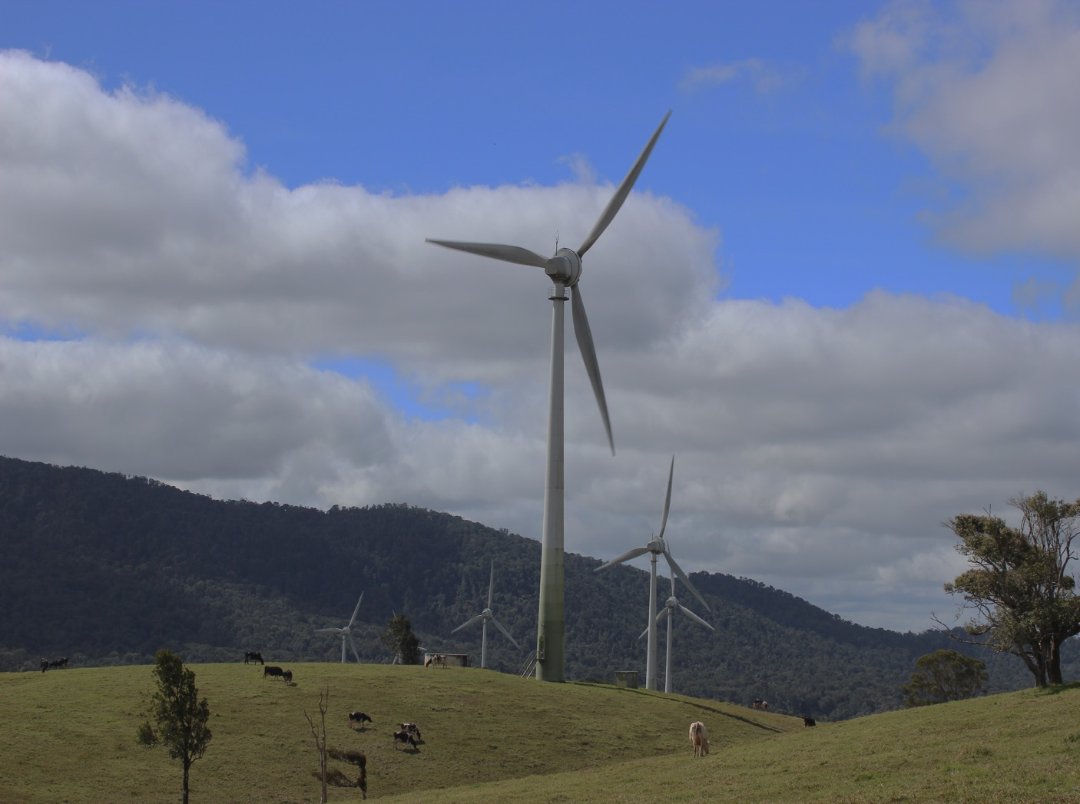
Disadvantages
There may be interruptions to electricity supply because wind is unpredictable.
Areas of high wind are usually near the coast, so land may be expensive.
Migrating flocks of birds tend to like strong winds and might collide with wind generators.
Wind generators may affect telecommunication reception.

Slide 6
Attributions
Slides 1, 3 & 4: Image courtesy of Joseph Sambono. Used with permission.
Slides 2 & 5: Image courtesy of Kerenza Misso. Used with permission.

